Slide 1
Сhallenges of the war for Ukrainian legal system: view of private law
HALYNA HRYTSENKO,
Attorney, PhD, Associate Professor
Department of civil, economic and financial law of Poltava law institute of Yaroslav the Wise National Law University

Slide 2
621 day of a full-scale military aggression of Russia against Ukraine
2024 – a 10-th year of Russian-Ukrainian war (which started in 2014).

Slide 3
Since 2014 the UN General Assembly has recognized:
Illegality of referendum in Crimea - Resolution of the General Assembly of the United Nations "On the Territorial Integrity of Ukraine" dated March 27, 2014 No. 68/262
Russia’s occupation of the territories of Crimea and Donbass- resolutions of the General Assembly of the United Nations "The state of affairs in the field of human rights in the Autonomous Republic of Crimea and the city of Sevastopol (Ukraine)" A/RES/71/205 (2016), A/RES/72/190 (2017), A/RES/73/263 (2018), A/RES/74/168 (2019), A/RES/75/192 (2020); "Problems of the militarization of the Autonomous Republic of Crimea and the city of Sevastopol, Ukraine, as well as parts of the Black and Azov Seas" A/RES/73/194 (2018), A/RES/74/17 (2019), A/RES/75/29 ( 2020),
Act of aggression of Russia against Ukraine- Resolution of the General Assembly of the United Nations "Aggression against Ukraine" A/RES/ES-11/1 of March 2, 2022

Slide 4
Types of legal regimes caused by Russian-Ukrainian war
ATO(2014-2018),
JFO (2018-Feb.24, 2022),
martial law (1 month in 2018 and from Feb.24, 2022 - …)

Slide 5
Martial law 2018

Slide 6
Martial law 2022
The actual work of courts, operation of state registers
Exemption from liability for violation if civil law obligations during martial law: a) monetary obligations under loans contracts; b) force majeure
Restrictions of rights in the field of private law during martial law: a) general restrictions on rights; b) nationalization of property of the Russian Federation and its residents in Ukraine; c) restriction of transactions with the Russian Federation and its residents or in their favor

Slide 7
Martial law 2022: challenges for courts
During the martial law the powers of the courts cannot be suspended, Reduction or acceleration of any forms of judicial proceedings is prohibited.
Statistics of court decisions:
In the first half of 2022, 1,160,000 cases were submitted to the courts (46% less than in the same period of 2021).
Quantity of cases submitted to the Supreme Court also decreased by 40%.
From 24.02.2022 to 01.06.2022 the courts of Ukraine passed approximately 1 mln court decisions.

Slide 8
Martial law 2022: challenges for courts
Key factors that helped Ukrainian courts to continue to administer justice
Extension of general and special statute of limitations for the period of martial law
Renewal of procedural terms (not automatic)
Changes in the territorial jurisdiction of cases
Activation of online justice

Slide 9
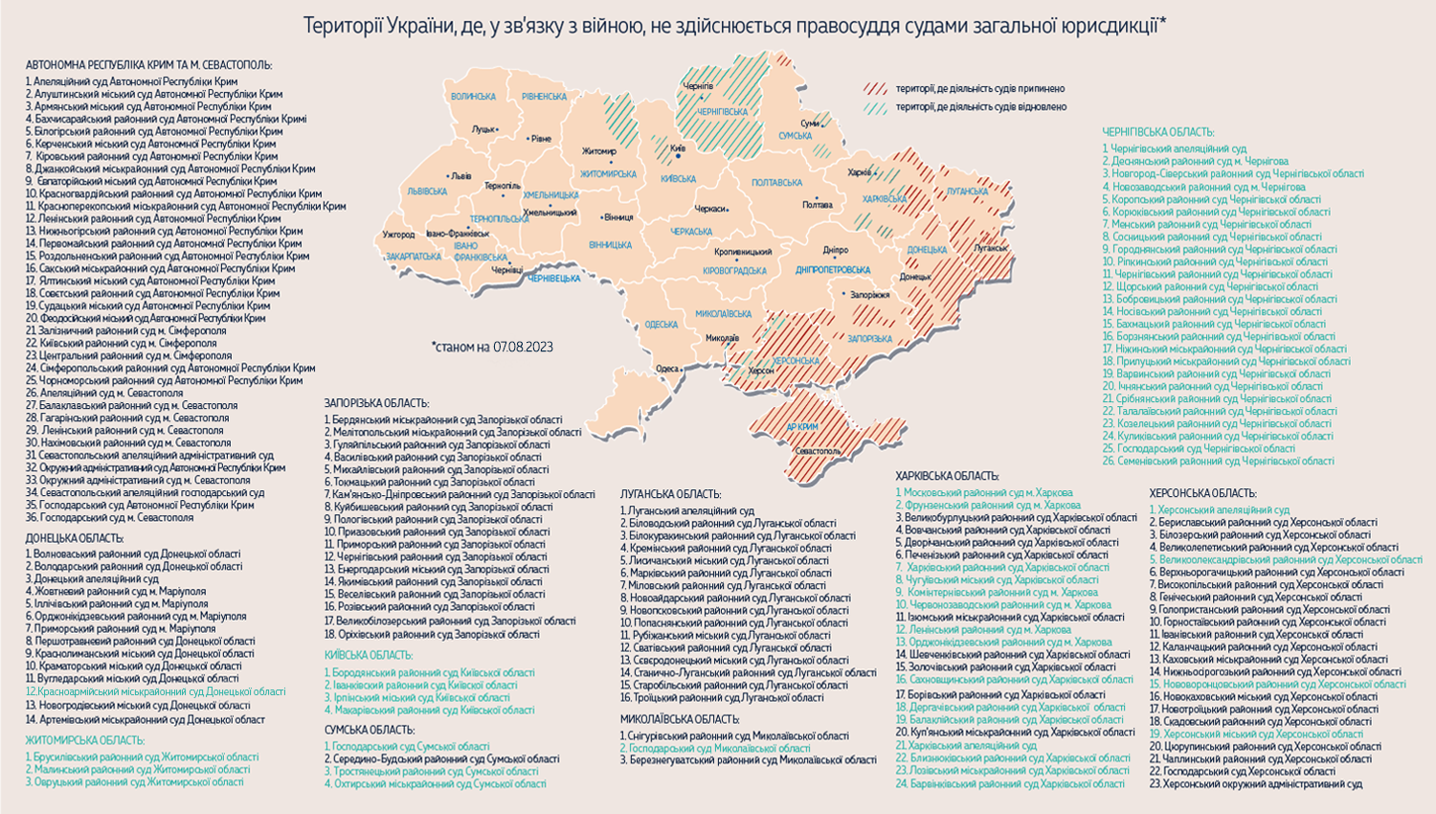

Slide 11
Court decisions in high-profile cases
Resolution of the Grand Chamber of the Supreme Court dated May 12, 2022 in case No. 635/6172/17 ‘Regarding the mechanism of compensation by the State of Ukraine for moral damage caused by the death of an individual during the armed conflict with the Russian Federation’
Resolution of the Grand Chamber of the Supreme Court dated May 12, 2022 in case No. 635/6172/17 ‘Regarding the judicial immunity of the Russian Federation in disputes about compensation for damage caused by the aggressor state to an individual’

Slide 12
Martial law 2022: operation of state registers
State registers
Never stopped functioning: e.g. register of inheritance cases, register of power of attorneys, register of of acts of civil status
Renewed functioning in several months: e.g.register of property rights to real estate, register of encumbrances on movable property, register of legal entities and individual entrepreneurs;
NEW registers: e.g. register of damaged assets

Slide 13
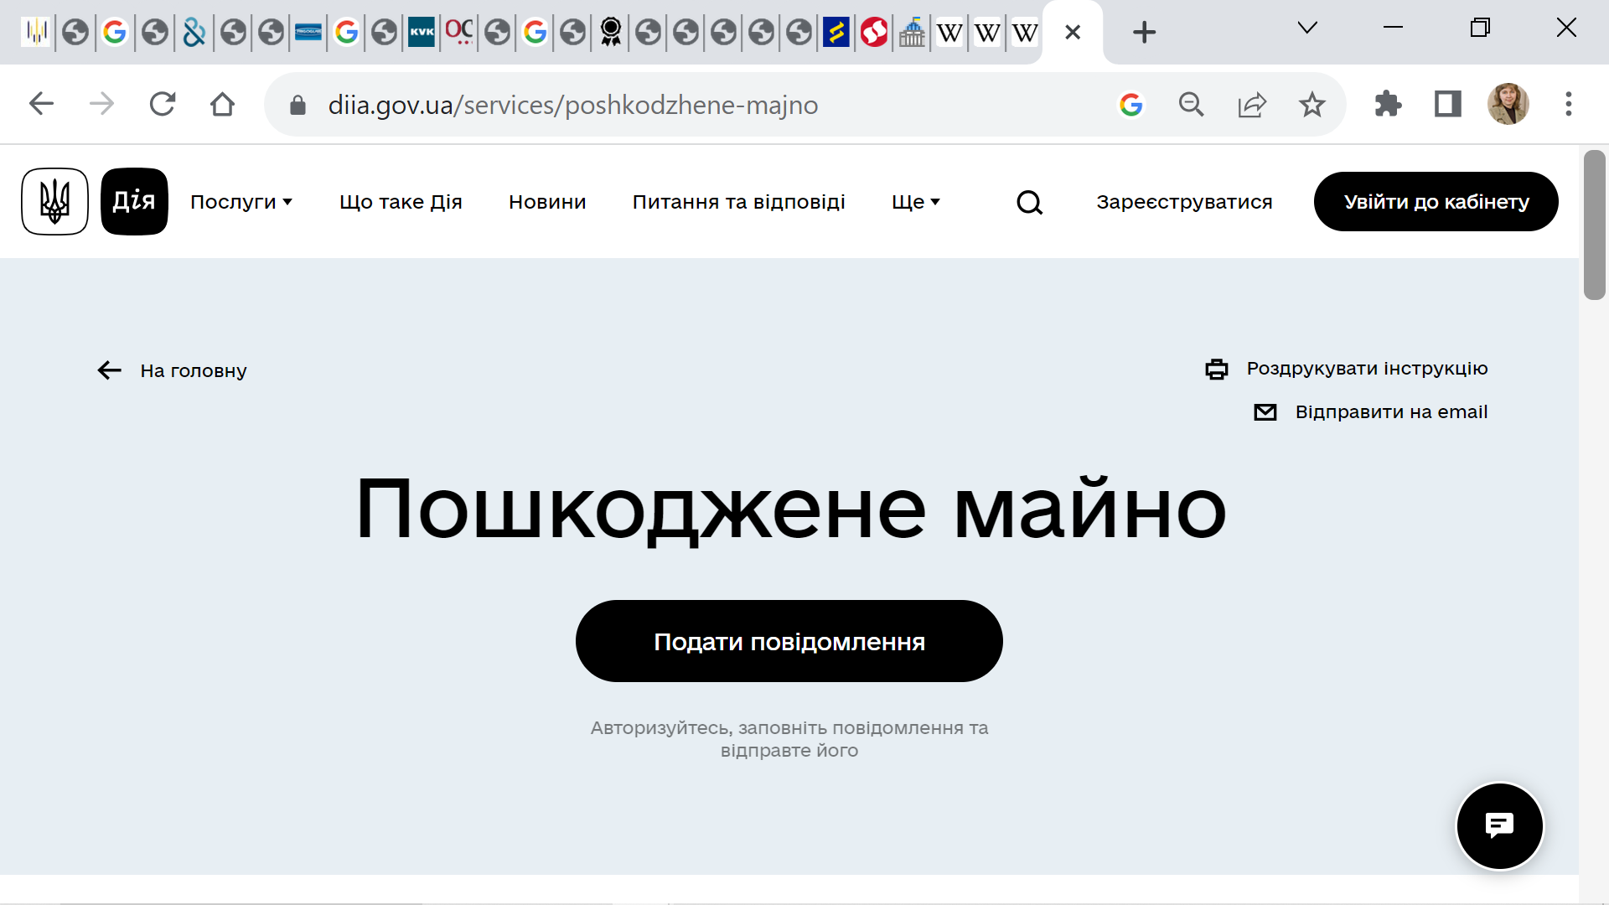

Slide 14
Martial law 2022 : General restrictions of rights in the field of private law
movement restrictions (curfew, roadblocks, light masking regime etc.)
work obligation,
forcible ownership expropriation
use the capacities and labor resources of enterprises

Slide 15
Martial law 2022: exemption from liability for violations of civil obligations
a) monetary obligations under credit contracts (loans);
- Credit holidays for borrowers-consumers
Exemption of borrowers from LIABILITY for breach of MONETARY obligation under SPECIFIC contracts - credit contract (contract of loan) - during martial law + 30 days days after its termination or cancellation.
in the case of temporary occupation, - the exemption from the credit obligation itself
b) force majeure the CCI certificate on force majeure circumstances cannot be considered unconditional evidence of their existence

Slide 16
Martial law 2022 : forced seizure of property of the Russian Federation and its residents in Ukraine
Law of Ukraine dated 03.03.22 № 2116-IX ‘On the main principles of forced seizure in Ukraine of objects of property rights of the Russian Federation and its residents
- legal entities of Ukraine with Russian beneficiaries
Draft Law #7169 dated March 15, 2022
+ Individuals - citizens of the RF (except for some persons), as well as persons who are not are citizens of the RF, but have the closest connection with the RF

Slide 17
Draft Law #7169 dated March 15, 2022
To residents within the meaning of this Law by decision of the National Council security and defense of Ukraine or the court can be equated to individuals or legal entities (regardless of citizenship, main activity etc.), who are :
permanently or temporarily outside Ukraine occupied territory of Ukraine and
publicly deny or support implementation of armed aggression of the RF against Ukraine, establishing and approval of the temporary occupation of part of the territory of Ukraine and
which are not have stopped or not stopped the implementation of their economic (in particular economic) activity on the territory of the RF during the period of validity martial law in Ukraine, introduced in connection with the implementation of armed aggression of the RF against Ukraine

Slide 18
Martial law 2022 : restriction of transactions with the RF and its residents or in their favor
Resolution of the Cabinet of Ministers of Ukraine dated 03.03.22 #187 ‘On ensuring the protection of national interests in future lawsuits by the state of Ukraine in connection with the military aggression of the Russian Federation’
MORATORIUM
1) performance, including by force, of monetary and other obligations if creditors (collectors) are the Russian Federation or the following persons: citizens of the Russian Federation , legal entities of Ukraine with Russian beneficiaries, foreign legal entities with Russian beneficiaries in case of fulfillment of obligations to them at the expense of funds provided for in the state budget

Slide 19
Martial law 2022 : restriction of transactions with the RF and its residents or in their favor
MORATORIUM
2) Alienation and similar transactions (like mortgage and any other actions that can result in alienation of some assets - real estate, securities, corporate rights, rights of claim against the debtor in cases of bankruptcy (insolvency), vehicles, air and sea vessels, inland navigation vessels –by the Russian Federation or persons associated with the Russian Federation (EXCEPT for: free alienation/transfer in favor of the state of Ukraine)
3) -//- in favor of the Russian Federation or persons associated with the Russian Federation(EXCEPT for court decision or a certificate of the right to inheritance)

Slide 20
Thank you for attention
Halyna Hrytsenko
+380503036329, ggritsenko@gmail.com

